Slide 1
Remote Emotion Detector V2
Lucas Therrien

Slide 2
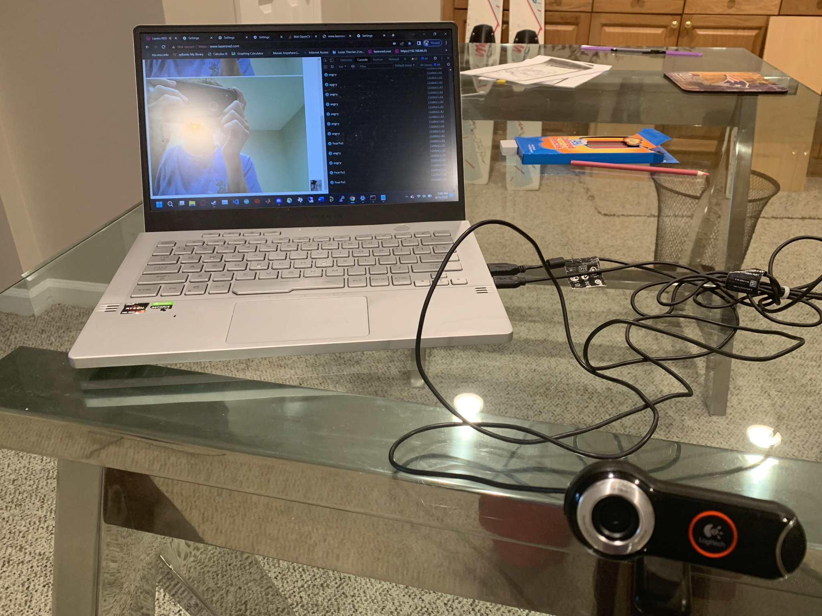
What was version 1?
Version 1 was my first true ML Project
Why come back to it?
I’ve learned a lot since this previous Summer
The original version was not very effective, achieving only 64% validation accuracy during training
Struggled to identify emotions such as anger and disgust when tested live

Slide 3
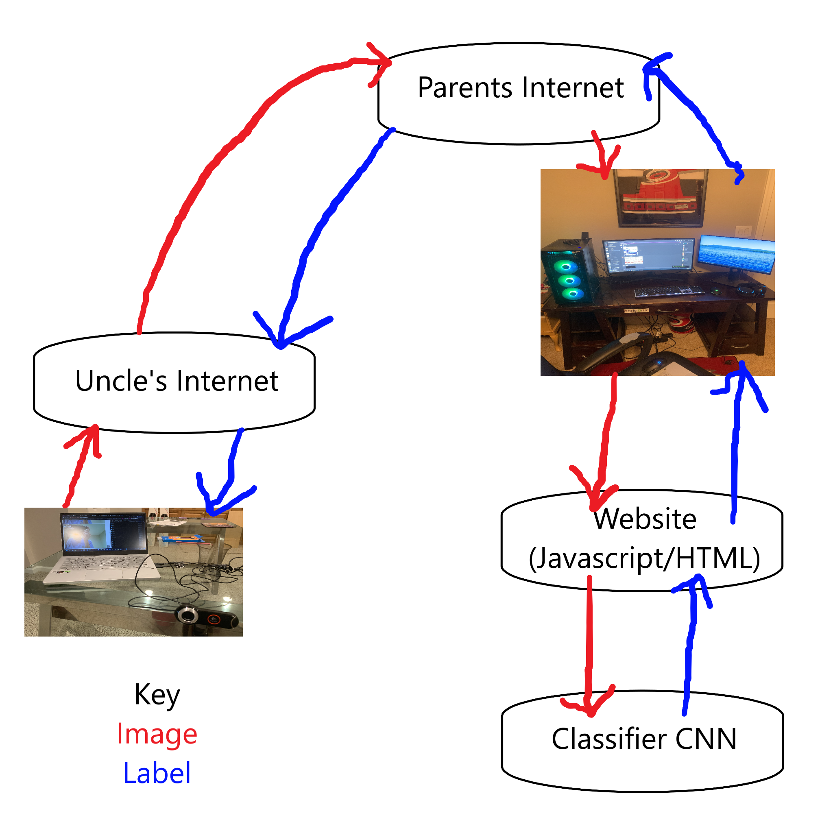
Brief overview of the detector’s web interface

Slide 4
Dataset
The big reason version 1 was so ineffective was that it used a dataset of 64x64 images, which were far smaller than the webcam I used.
Was originally going to use the Caltech 10k Faces dataset [1], but this dataset was labeled for facial features (nose, eyes, etc.) rather than emotional classification
Ultimately settled on using the Extended Cohn-Kanade Dataset [2][3], which had a decent amount of 640x480 images already labeled with the 7 emotions from the original dataset
Anger, disgust, neutral, sadness, happiness, surprise, fear

Slide 5
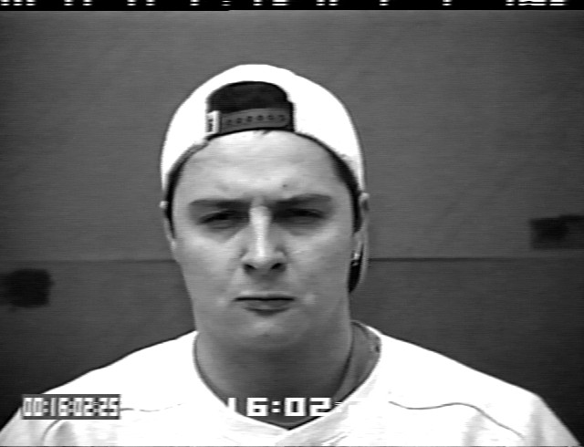

Dataset, old vs new

Slide 6
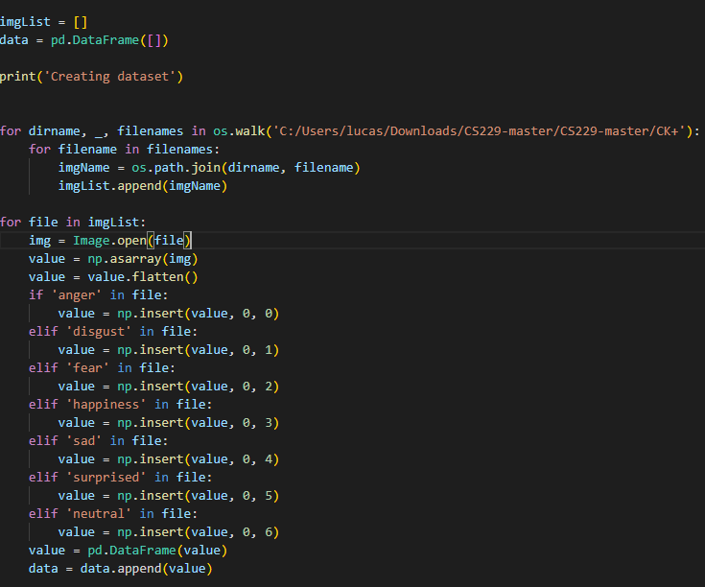
The first major issue, dataloading
The old model did not make use of a dataloader
This was fine for the 64x64 images, but the new data was far too large to be loaded from a csv
It was much easier to set the dataloader up for Keras than for Pytorch (more on this in the next slide)

Slide 7

The second major issue, GPU Memory
I trained this model on my gaming PC, which among other things has an RTX 3060 with 8 GB of RAM.
This was easily exhausted by the sheer massive scale of this model, easily the biggest I’ve ever tried to train (architecture shown on next slide)
Mitigation measures included:
Reducing batch size from 64 to 8 (yes this was absolutely necessary)
Moving some parts of the model off the GPU
Closing some open tabs, especially the one with the Project Zomboid map

Slide 8
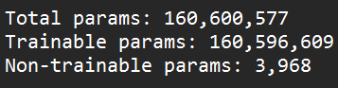
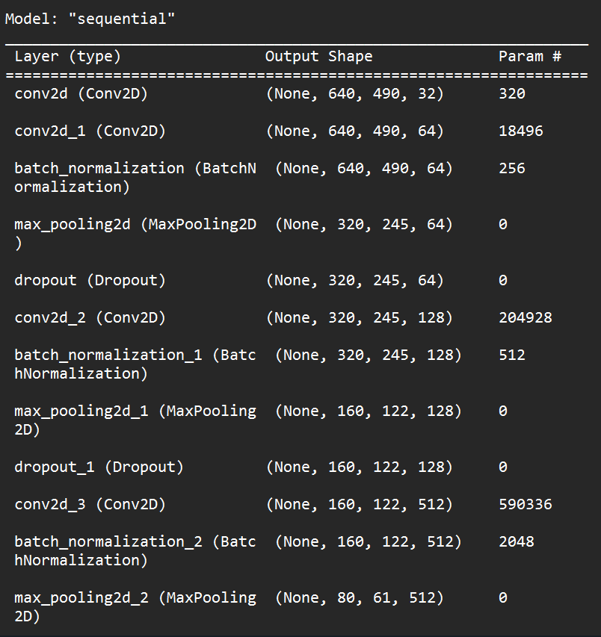
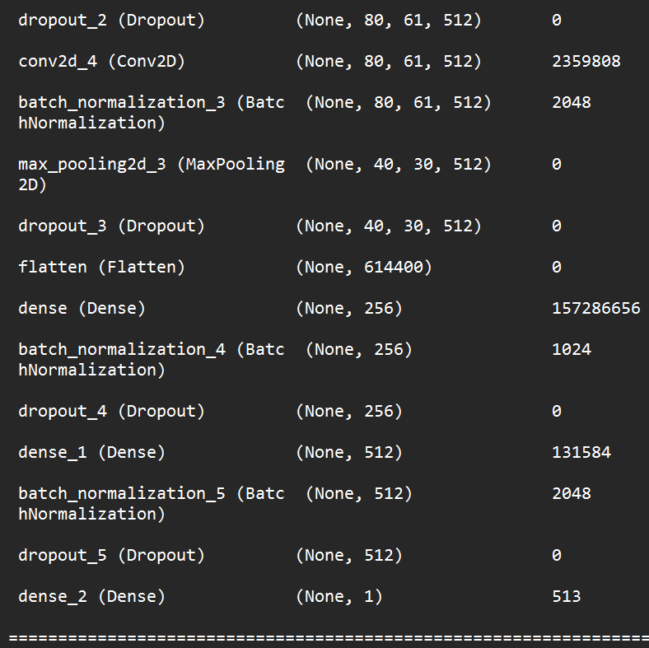
Tensorflow CNN Model

Slide 9
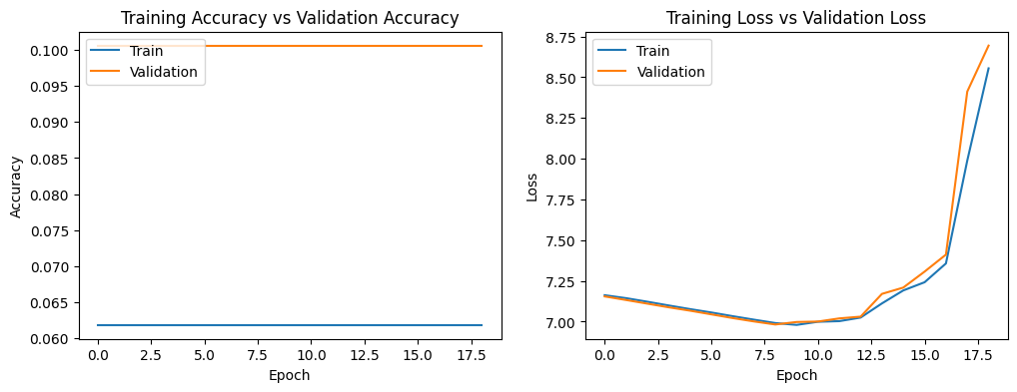
The last major issue, the old model architecture sucks
Learning rate: 0.001

Slide 10
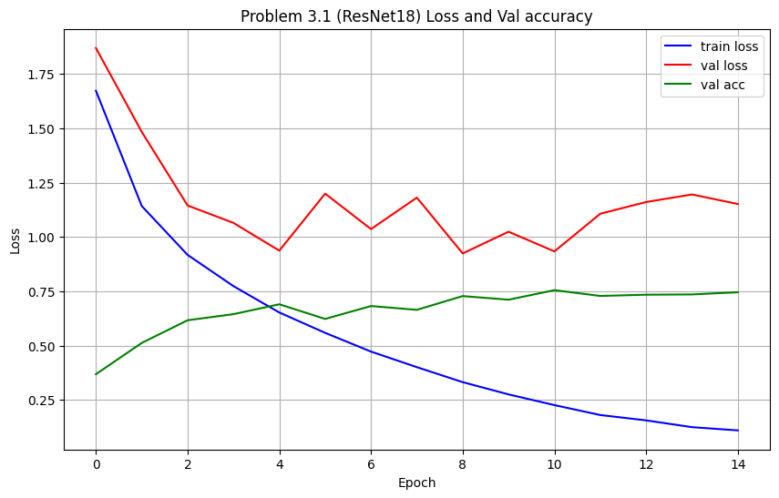
Good ol’ reliable ResNet
ResNet was the most reliable model I used in this class, at least for image classification.
In particular I chose ResNet18, as out of all the models trained for homework 3, it performed the best in terms of accuracy and loss.

Slide 11
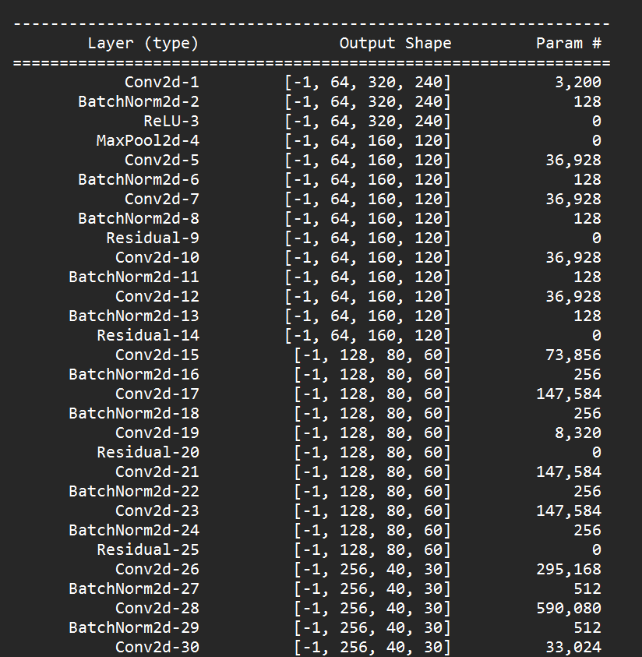
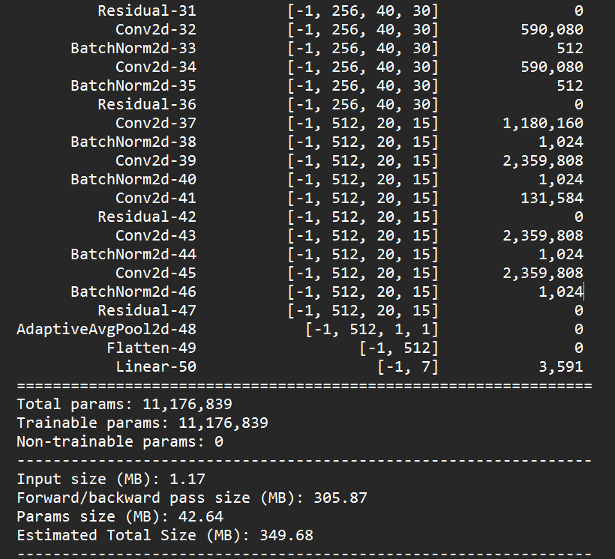
ResNet Model Architecture

Slide 12
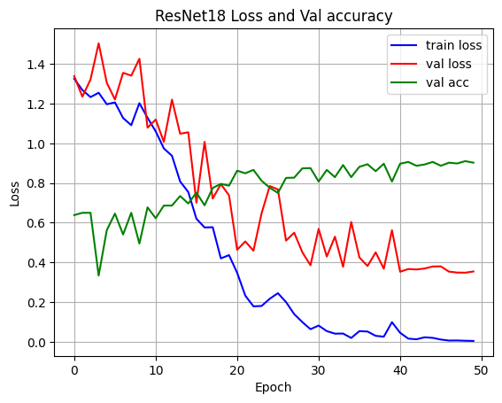
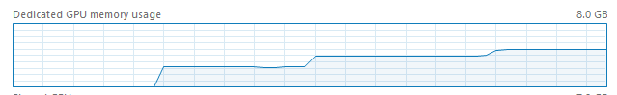
ResNet Training
Actually trained this time, already infinitely better
Achieved a peak validation accuracy of ~91% on epoch 49
Learning rate set to 0.01
Used about 5 GB of GPU RAM when running

Slide 13
Real-life testing
TODO
Gonna be honest, this took quite an effort to train, both in hardware and development. I also did this alone which added an extra layer of challenge.
2 near heart-attack moments:
Accidently overwrote the majority of my code, saved by VS Code’s version history
Accidently uninstalled Pytorch and messed up CUDA (GPU) integration, luckily was able to fix this.
Currently just trying to run the loaded model back on the validation set, ran into more weird issues with GPU Memory.

Slide 14
Sources
[1] “Caltech 10K Web Faces.” Perona Lab - Caltech 10k Web Faces, www.vision.caltech.edu/datasets/caltech_10k_webfaces/. Accessed 9 May 2023.
[2] P. Lucey, J. F. Cohn, T. Kanade, J. Saragih, Z. Ambadar and I. Matthews, "The Extended Cohn-Kanade Dataset (CK+): A complete dataset for action unit and emotion-specified expression," 2010 IEEE Computer Society Conference on Computer Vision and Pattern Recognition - Workshops, San Francisco, CA, USA, 2010, pp. 94-101, doi: 10.1109/CVPRW.2010.5543262.
[3] Spenceryee. (n.d.). Spenceryee/CS229. GitHub.
https://github.com/spenceryee/CS229/tree/master

Slide 15
Questions?

